Slide 1
Licence Regulations
Licence Regulations

Slide 2
UK Licence Classes
Foundation
Intermediate
Full

Slide 3
Privileges
Full licensees have various privileges which are not available to Foundation and Intermediate licensees.
e.g. Foundation/Intermediate licensees are not permitted use some frequencies such as the 5MHz band.

Slide 4
Callsign Formats (in England)
Foundation M3ABC M6ABC M7ABC
Intermediate 2E0ABC 2E1ABC
Full M0ABC M1ABC M5ABC G0ABC, G1ABC to G8ABC
Note: The 0 above is a Zero (not the letter O)

Slide 5
England & Outside of England (Full licence)
Secondary Identifiers (W, I, D, J, U, M)
England M0ABC
Wales MW0ABC
N. Ireland MI0ABC
Isle of Man MD0ABC
Jersey MJ0ABC
Guernsey MU0ABC
Scotland MM0ABC

Slide 6
Call signs – Full
In England - G, M0, M1, M5
G2PA G3BJ G4CW G5MW
G0BSP G1AAC G2XYZ
G3EFX G4QQQ G5AYG
G6QZZ G7QNH G8QAG
Notes:
Some pre-war 2 letter G callsigns

Slide 7
Regional Secondary Locators (RSL) (Foundation & Intermediate)
Secondary Identifiers (W, I, D, J, U, M)
Wales MW7ABC 2W0ABC
N. Ireland MI7ABC 2I0ABC
Isle of Man MD7ABC 2D0ABC
Jersey MJ7ABC 2J0ABC
Guernsey MU7ABC 2U0ABC
Scotland MM7ABC 2M0ABC England M7ABC 2E0ABC

Slide 8
Main Station Address
As shown on the front page of the licence document i.e. Section 1. This is the principal location where Ofcom authorise operation of the station. The Main station address must be in the UK. Callsign suffixes ( /A, /P, /M & /MM) do not apply at the Main Station address.

Slide 9
Alternative Address
“Alternative Address” means a fixed postal address in the United Kingdom other than the Main Station Address. The callsign suffix “/A” may be used at such a location.
e.g. M0ABC/A

Slide 10
Mobile
When the equipment is located in or on any vehicle or conveyance, or on the person of the licensee where the licensee is a pedestrian or on any vessel on Inland waters. The callsign suffix “/M” may be used.
e.g. M0ABC/M

Slide 11
Temporary Location
“Temporary Location” means a fixed location in the United Kingdom which is not the Main Station Address or an Alternative Address. This could be in a field or campsite. The callsign suffix “/P” may be used at such a location.
e.g. M0ABC/P

Slide 12
Maritime Mobile
“Maritime Mobile” means the Radio Equipment is located on any Vessel at Sea. The callsign suffix “/MM” may be used in such a situation.
e.g. M0ABC/MM
Note that the regional secondary locator (D, I, J, M, U or W) is NOT used when operating Maritime Mobile.

Slide 13
Vessel
A “Vessel” means any floating structure which is capable of being manned.

Slide 14
Vessel at Sea
“Vessel at Sea” means a vessel operating on the seaward side of the low-water line along the coastline as marked on large scale charts officially recognized by the relevant coast state.
Foundation and Intermediate licensees are allowed to transmit in UK coastal waters ie up to the territorial limit- usually 12 nautical miles.

Slide 15
Vessel’s Master
1. Before installing, using or changing amateur radio equipment on board a vessel, you must get written permission from the master.
2. You must cease operation or maintain radio silence if commanded by the master.
3. You must keep a log of all transmissions if the master requests it.

Slide 16
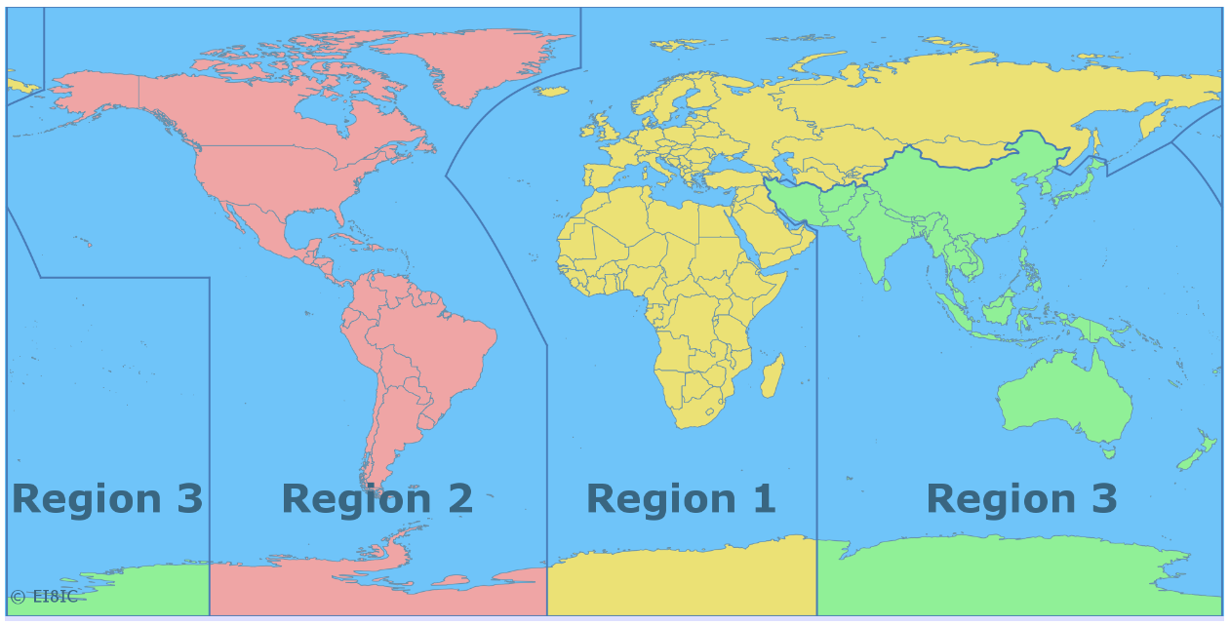
ITU Amateur Regions

Slide 17
ITU Frequencies
The ITU (International Telecommunications Union) Radio Regulation (RRs) specify the frequencies used in each region.

Slide 18
Callsign Suffixes
Callsign suffixes (/A, /P, /M, /MM) are
OPTIONAL
Regional Secondary Locators (D, I, J, M, U or W) are
MANDATORY

Slide 19
Callsign – When ?
You must give your callsign CLEARLY AT ALL TIMES
Your callsign must be transmitted AS FREQUENTLY AS IS PRACTICABLE during transmissions
The callsign must be given by VOICE or other APPROPRIATE FORMAT consistent with the mode of operation
It is good practice to give your callsign more often
e.g. at the end of each “over”.

Slide 20
Identification
Identification (your callsign) should be given
During the initial transmission
Change of frequency
Change of mode eg FM to SSB
Change of operator (unless under supervision)
Change of supervisor
Change of RSL (Regional Secondary Locator)

Slide 21
Airborne Operation
AIRBORNE operation is forbidden at ALL levels of Amateur licence in the UK.

Slide 22
CEPT & International
CEPT – Conference European of Postal and Telecommunications.
An agreement between many countries (mostly European) whereby UK Full licensee amateurs can operate abroad.
The two important sections are:
T/R 61-01 and T/R 61-02

Slide 23
CEPT T/R 61-01
T/R 61-01 allows UK Full licensees to operate in CEPT countries for SHORT visits eg holidays.

Slide 24
CEPT T/R 61-02
T/R 61-02 allows UK Full licensees to operate in CEPT countries for LONGER visits by applying for a local licence under the Harmonised Amateur Radio Examination Certificate (HAREC) scheme.

Slide 25
HAREC Certificate - 1
In the UK, when a candidate passes the Full exam (via the Foundation-Intermediate-Full or Direct-to-Full route), the RSGB will provide a HAREC certificate.

Slide 26
HAREC Certificate - 2
T/R 61-02 allows HAREC certificate holders to apply for a top level licence in a CEPT country.

Slide 27
Reciprocal Licences
Many countries, (including non-CEPT) will offer reciprocal licences to UK amateurs who have a HAREC Full licence.
Such operation must be in accordance with the host country’s rules.

Slide 28
CEPT
The CEPT facility does NOT extend to Reciprocal or club licences.

Slide 29
CEPT - Rules
When operating under a CEPT arrangement, amateurs must abide by the local licence regulations.

Slide 30
Messages - 1
Messages (e.g. conversations) can ONLY be sent to other radio amateurs or to the stations of other amateurs.

Slide 31
Messages - 2
In an international disaster:
- messages may be passed, internationally, on behalf of non-licensed persons
- non-amateur stations may be heard on amateur frequencies

Slide 32
Messages - 3
Conversations can be established between three or more stations as long as contact is confirmed (i.e. callsign exchange) with at least one member of the group. Such groups are are known as “networks” or “nets”.

Slide 33
Messages - 4
UK amateurs may receive amateur signals on non-UK frequencies but must reply on UK frequencies.
For example, amateurs in the Americas are allocated frequencies between 7.0 and 7.3 MHz but the UK allocation is only 7.0 to 7.2 MHz.

Slide 34
Messages - 5
Amateurs may record transmissions from another amateur and then re-transmit them to the original amateur or any other specified amateur. However, if the recording includes any callsigns, the re-transmission must make the origin of the transmission very clear.

Slide 35
Messages - 6
People of all ages and backgrounds may be listening to amateur transmissions, therefore, it is important that messages do not cause offence. The Wireless Telegraphy act (1988) and the Communications Act (2003) apply.

Slide 36
Messages - 7
No business use
No advertising
Messages on behalf of “User Services” are OK eg Red Cross
People from User Services may even operate the equipment - e.g. press the transmit switch

Slide 37
Codes & Encryption - 1
Secret codes and encryption are NOT permitted (encryption means deliberately obscuring the meaning of a message)
Non-secret codes, e.g. Morse code, are ok
Q codes are often used in amateur radio

Slide 38
Codes & Encryption - 2
Encryption may be allowed when a User Service such as paramedics require it to maintain personal confidentiality.
If a message is intended for reception overseas then no encryption is allowed.

Slide 39
Operators
The only persons allowed to operate your Radio Equipment and callsign are:
- You.
- another licensed (UK or non-UK) amateur
- the holder of a Radio Amateur pass certificate
- a student on a recognised training course
All above (except you obviously) must operate under your direct supervision.

Slide 40
Disqualified Operators
You must not let a disqualified person operate your station.
There is no list of disqualified persons so all you can do is ask them !!

Slide 41
Amateur Radio Certificate
Examining bodies e.g. RSGB, can provide an Radio Amateur’s pass Certificate to anyone who has passed a Foundation, Intermediate or Full exam. This certificate can be used when applying for a UK transmitting licence.

Slide 42
Supervision - 1
Any UK licensed amateur (Foundation, Intermediate or Full) can supervise any other UK licensed amateur providing that the supervisor’s callsign is used and that the supervisor is present to ensure that the regulations appropriate to the callsign are adhered to.

Slide 43
Supervision - 2
A Foundation licensee can operate a Full licensee’s station up to 400* Watts and on any amateur frequency by using the supervisor’s full callsign.
*on some bands, the maximum power is less than 400 watts

Slide 44
Supervision - 3
A Full licensee can operate a Foundation licensee’s station and callsign but is limited to the Foundation regulations e.g. 10 Watts and must be supervised by the Foundation licensee !!

Slide 45
Who can operate what?
The callsign is the key
Your callsign – you are responsible
Another callsign – they are responsible

Slide 46
Supervision - 4
There are three circumstances when an unlicensed person may use amateur equipment on amateur frequencies:
Training course
Greetings messages
User Services

Slide 47
Training Courses – 1
If a student is studying to take a UK amateur radio exam (Foundation, Intermediate, Full or Direct to Full) a Full licensee can supervise the student to operate a station so as to practise “on air” procedures.

Slide 48
Training Courses – 2
A “training course” should be formally arranged in advance e.g. by email, and could be as simple as a single on-air contact with self study for the other parts of the syllabus.

Slide 49
Greetings Messages
A full licensee can supervise a non-licensed person e.g. a scout to send a greetings message to another radio amateur. The supervisor must stay in total control of the station with the visitor simply talking into the microphone. The remote station must agree, in advance, to receive such a message.

Slide 50
User Services
Under certain circumstances* you may allow a member of a “User Service” to use your equipment.
*emergencies or rehearsals for potential emergencies

Slide 51
User Services
Police* Fire* Ambulance*
Coastguard* local government*
British Red Cross
St John Ambulance
St Andrews Ambulance Association
Salvation Army
any Government Department
Royal Voluntary Service
* Included in category 1 & 2 responders

Slide 52
“Radio Equipment”
The licence often uses the term
Radio Equipment
(note the capital R and capital E)
This term means the station and it INCLUDES the callsign

Slide 53
Ofcom - 1
The Office of Communications is the UK regulatory body for Amateur Radio.

Slide 54
Ofcom - 2
You must immediately inform Ofcom if you change your name, main station address or mailing address.

Slide 55
Ofcom - 3
Ofcom can:
Inspect your station
Require modification
Restrict operation
Close down your station

Slide 56
Ofcom - 4
Such action is usually during an investigation of an interference
problem.

Slide 57
Ofcom - 5
Ofcom can request that you keep a log (a record) of all transmissions. This is usually done when investigating an interference problem.

Slide 58
Ofcom - 6
Ofcom can revoke your licence if you
contravene the licence regulations
fail to advise a change of name or address
fail to revalidate your details (at least once every five years)

Slide 59
Ofcom & BBC - 1
If an interference problem, to domestic radio or TV, cannot be resolved locally, the first contact is the BBC. If the BBC cannot solve the problem, they will involve Ofcom.
Notes:
No such thing as and Advanced Licence – take advanced EXAM to get FULL licence

Slide 60
Ofcom & BBC - 2
If Ofcom are called in to investigate an interference problem they can:
Request that you keep a log
Request modification to the equipment
Limit the transmit power
Prohibit operation during certain hours
Notes:
No such thing as and Advanced Licence – take advanced EXAM to get FULL licence

Slide 61
Frequency Schedules
Table C at the back of licence document (tables A & B relate to the Foundation and Intermediate licences) and the table in Schedule 2
A copy will be provided in the exam
No need to learn them, just get familiar so as to use them in the exam

Slide 62
Frequency Schedules - notes
Be aware that there are lots of notes that apply to the frequency schedules.

Slide 63
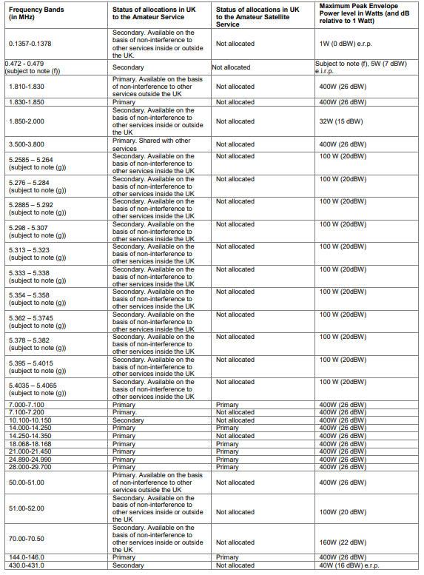
Frequency Schedule part 1

Slide 64
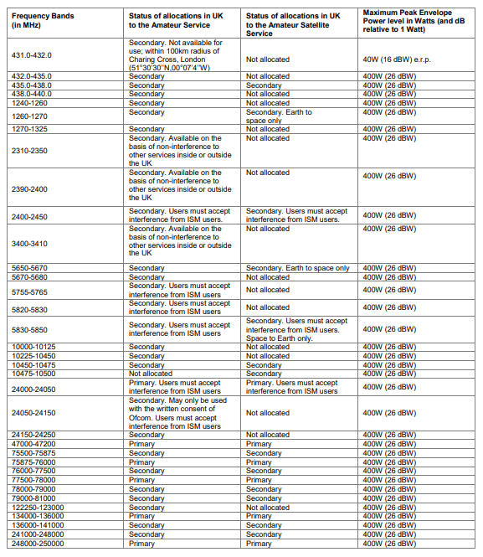
Frequency Schedule part 2

Slide 65
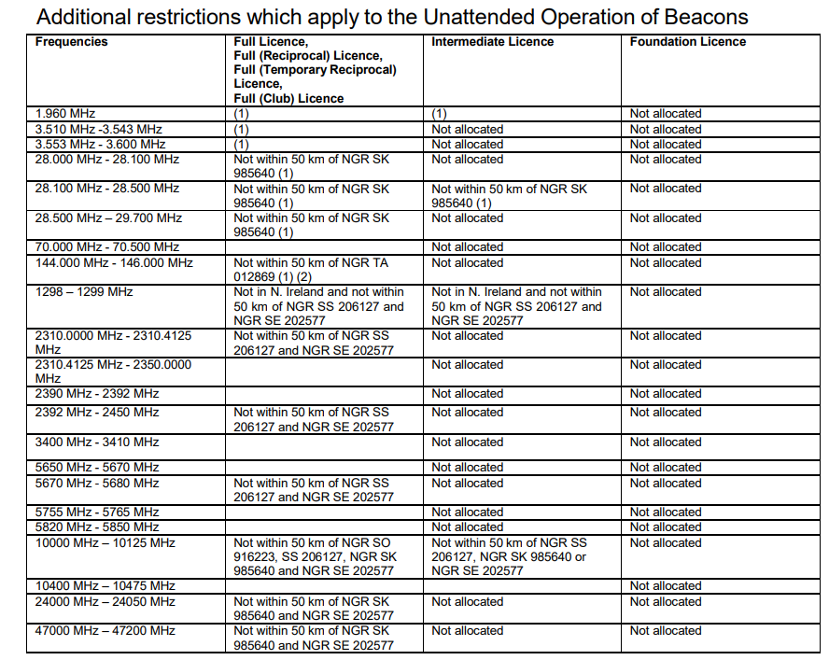
Schedule 2

Slide 66
Frequency Bands
66 lines in the schedule but only 27 separate amateur bands
e.g. 2nd, 3rd & 4th lines:
1.810 – 1.830
1.830 – 1.850
1.850 – 2.000
Combine to give 1.810 – 2.000 MHz

Slide 67
Amateur Bands – 1 (0.1357 to 70.500 MHz)
0.1357 – 0.1378 MHz 14.000 – 14.350 MHz
0.472 – 0.479 18.068 – 18.168
1.810 – 2.000 21.000 – 21.450
3.500 – 3.800 24.890 – 24.990
5.258 – 5.406 28.000 – 29.700
7.000 – 7.200 50.000 – 52.000
10.100 – 10.150 70.000 – 70.500

Slide 68
Amateur Bands – 2 (144MHz to 250 GHz)
144.000 – 146.000 MHz 24000 – 24250 MHz 430.000 – 440.000 47000 – 47200
1240.000 – 1325000 75500 – 81000
2300.000 – 2450.000 122250 – 123000
3400.000 – 3410.000 134000 – 141000
5650.000 – 5850.000 241000 – 250000
10000.000 – 10500.000

Slide 69
Unattended Operation - 1
Unattended operation is allowed for
- remote control of main station
- a beacon e.g. propagation test
- direction finding (DF) – eg foxhunt
- digital communications e.g. a packet node
but not for general use by others e.g. a voice repeater

Slide 70
Unattended Operation - 2
Unattended operation must be consistent with the terms of the licence.
Notes:
Some pre-war 2 letter G callsigns

Slide 71
Remote Operation
Full licensees may use any type of communication (radio, telephone, internet etc) for control of the main station.
Foundation and Intermediate licensees can only use low power radio.
Notes:
Some pre-war 2 letter G callsigns

Slide 72
Unattended & Remote - 1
Unattended and remote operation does NOT include provision for general use by other amateurs.
Such operation requires a “Notice of Variation” (NoV) e.g. a repeater
Notes:
Some pre-war 2 letter G callsigns

Slide 73
Unattended & Remote - 2
The remote control link must be FAILSAFE to avoid Unintended transmissions.
It must be adequately secure to ensure that the station remains compliant with the terms of the licence.
Notes:
Some pre-war 2 letter G callsigns

Slide 74
Remote control via Radio
If remote control is via an amateur radio frequency, the link must conform to the licence regulations and should be above 30 MHz.
Links must NOT be encrypted.
Notes:
Some pre-war 2 letter G callsigns

Slide 75
Apparatus/Equipment
Equipment must not cause undue interference
Must be designed to reduce interfering emissions e.g. harmonics
Notes:
Some pre-war 2 letter G callsigns

Slide 76
Transmitters
must be clean and stable
must not cause undue interference to other wireless telegraphy including domestic receivers e.g. radio & TV
you must carry out interference tests (from time to time)
Notes:
Some pre-war 2 letter G callsigns

Slide 77
Transmitters - bandwidth
Transmitted bandwidth should be kept to a minimum
no more than 1% of the mean power of the transmission should fall outside of the nominal modulated carrier bandwidth
Notes:
Some pre-war 2 letter G callsigns

Slide 78
Receivers
You must be able to receive on all frequencies and modes that are used for your transmissions.
Notes:
Some pre-war 2 letter G callsigns

Slide 79
EMF
ELECTROMAGNETIC FIELD
Since 2021, Ofcom have required radio amateurs to assess their station to ensure that members of the public are not subjected to unsafe levels of RF radiation.

Slide 80
EMF levels - 1
There are two levels which must not be exceeded:
An average limit - any higher may cause thermal heating
A peak limit - any higher may cause nerve stimulation

Slide 81
EMF levels - 2
Limits are defined by the International Committee on Non-Ionising Radiation Protection (ICNIRP).

Slide 82
EMF – who
With one exception, the term “public” means ANYONE who may come in range of the RF radiation. The only people it does not apply to are radio amateurs (they are expected to appreciate the risk of being near a transmitting antenna).

Slide 83
EMF – Power Levels
If the transmitted power level is less that 10 Watts EIRP average and less than 100 Watts EIRP peak then the RF fields are considered to be safe. If either is above these limits then it will be necessary to assess the system to determine the exclusion zone.
The details of the assessment, including a “below 10/100 Watts EIRP” statement need to be recorded.

Slide 84
EMF – System Changes
If the transmitted power level or any part of the antenna is changed then the assessment must be repeated and recorded.

Slide 85
EMF – Assessment
Ofcom and RSGB provide spreadsheets to assess each band/arrangement. Here is a sample of the RSGB form:

Slide 86
EMF – Emergencies
In the case of using the radio station to assist in an emergency operation, it is NOT necessary to perform an EMF assessment.

Slide 87
Licensing Regulations End

